Slide 1
Chapter 3
Classification
Muhammad Umar
UIAI Lab

Slide 2
Table of Contents
Introduction
Dataset Exploration
Loading and Preprocessing Data
Confusion Matrix
Precision Recall and F1 Score
Comparison of Performance Metrices
Error Analysis
Summary

Slide 3
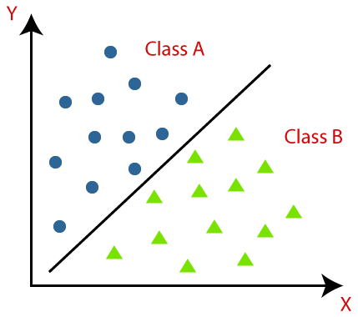

Introduction
In this chapter we will explore and experience the classification techniques used in Machine Learning.
What basically is Classification?
Classification is a supervised machine learning algorithms that aim to learn from labelled data and predict the class of new or unseen data.
Figure: Classification Graphically

Slide 4
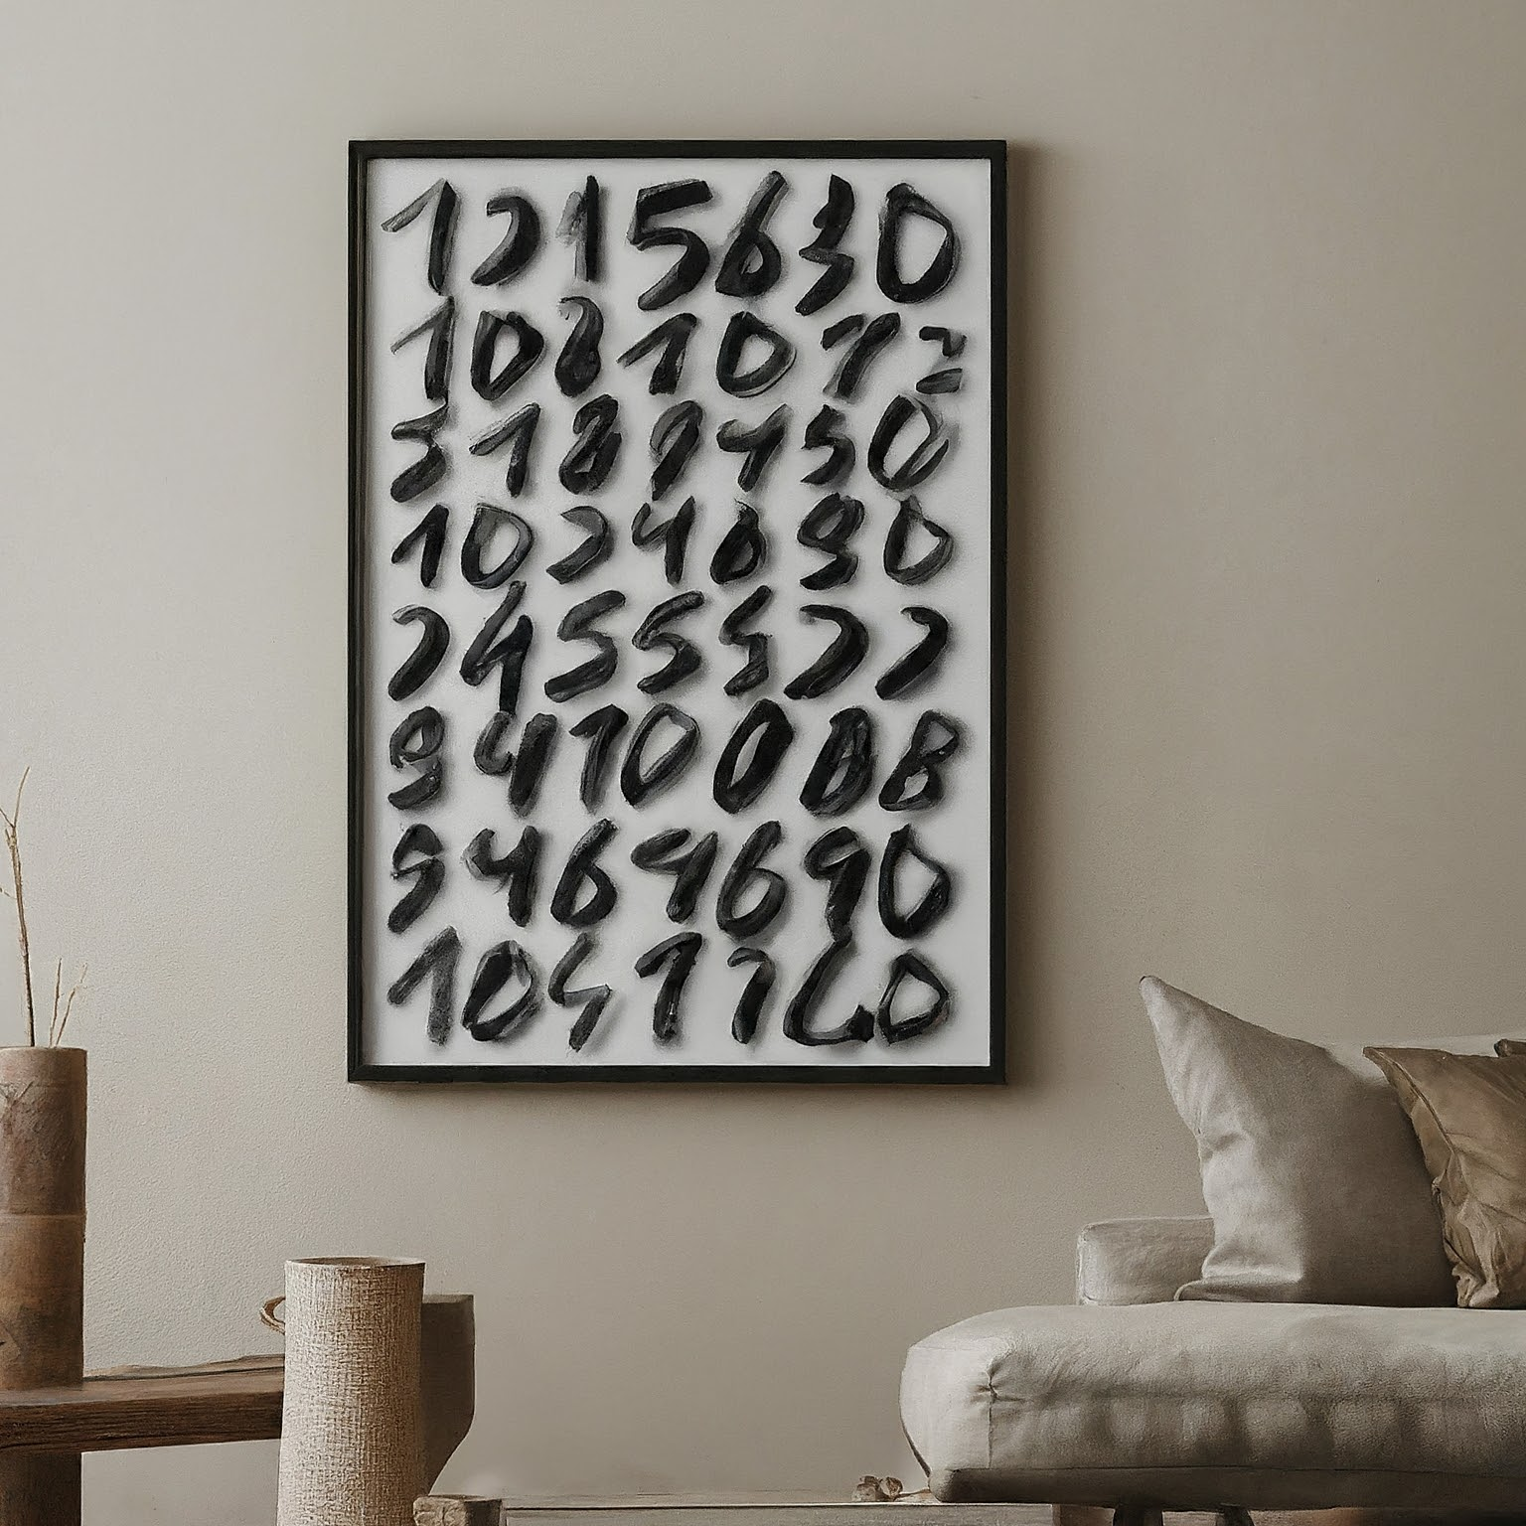
MNIST Dataset
Dataset Images = 70000 images
28x28 pixels = 784 pixels (features)
Every MNIST data point has two parts:
Image of the handwritten digit
Corresponding label (0-9)
Figure: MNIST Dataset

Slide 5
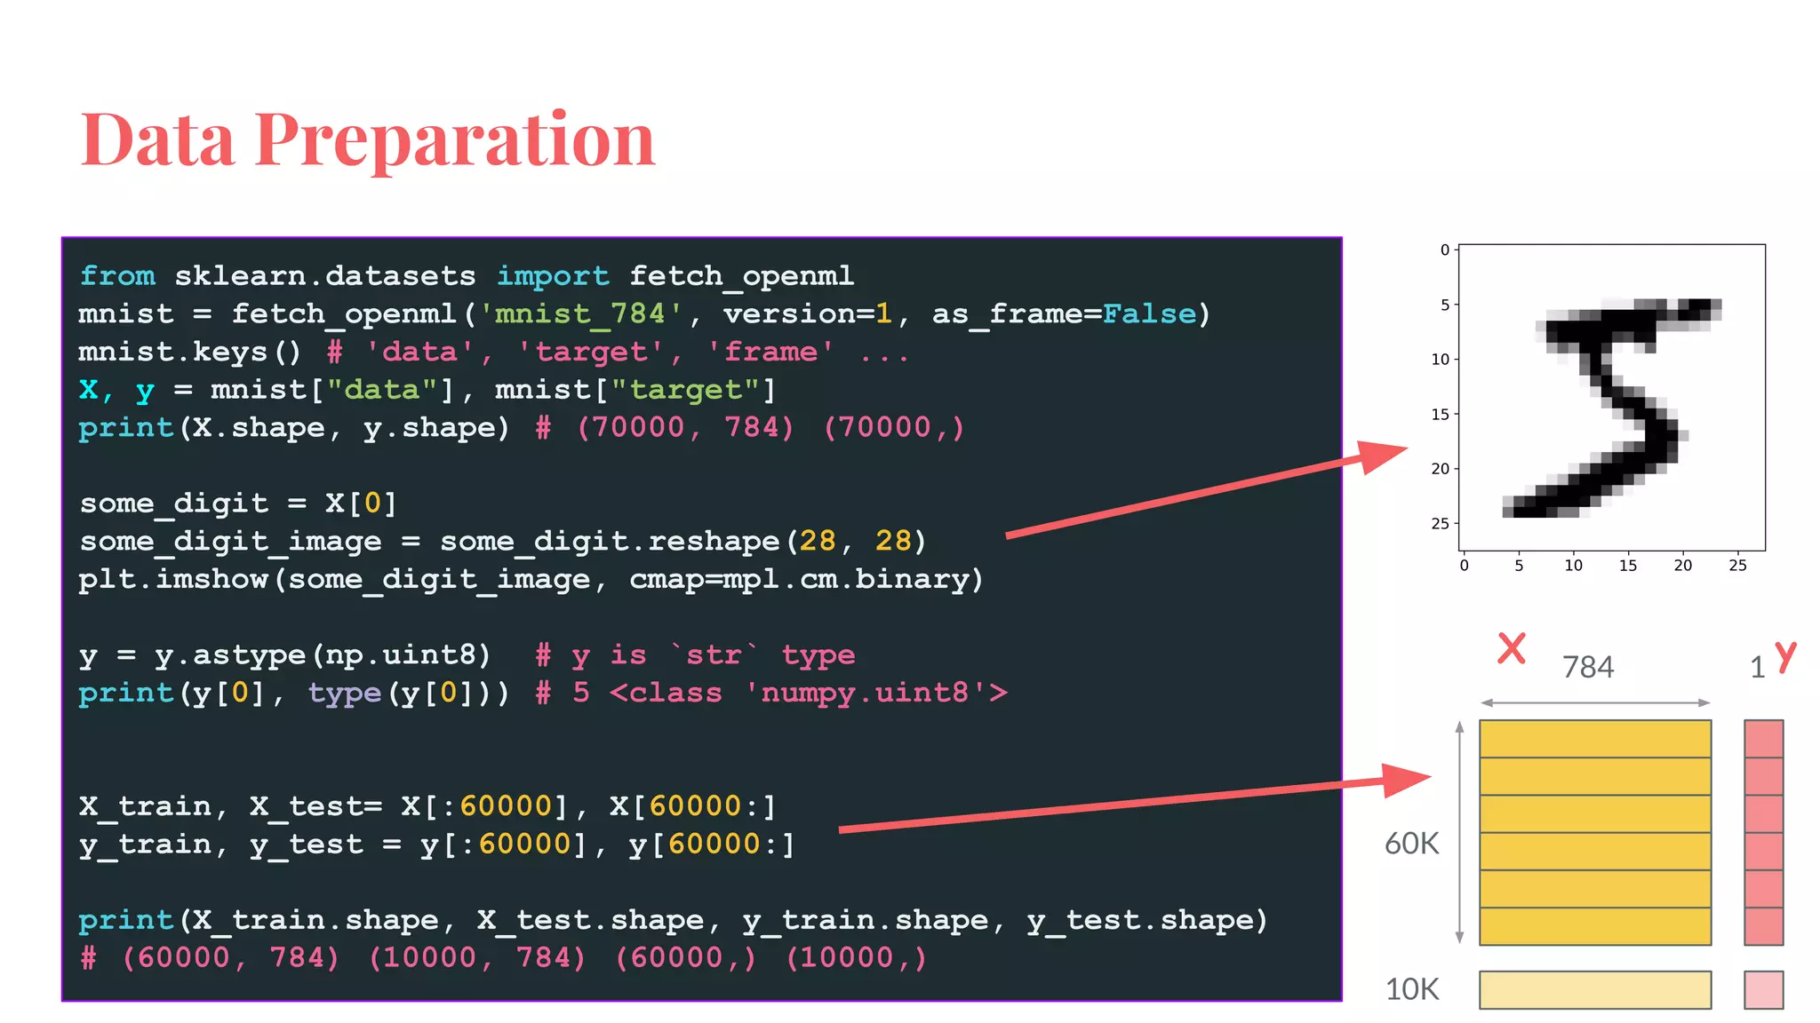
Loading and Preprocessing Dataset
Import necessary libraries.
Load the MNIST dataset from OPENML.
Separate features (X) and labels (y).
Figure: Data Preparation

Slide 6
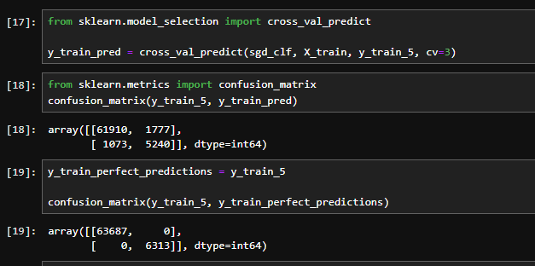
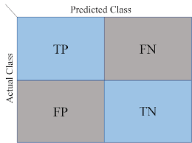
Confusion Matrix
A confusion matrix is a performance evaluation tool in machine learning, representing the accuracy of a classification model.
Figure: Code Evaluation of CM
Figure: Confusion Matrix

Slide 7
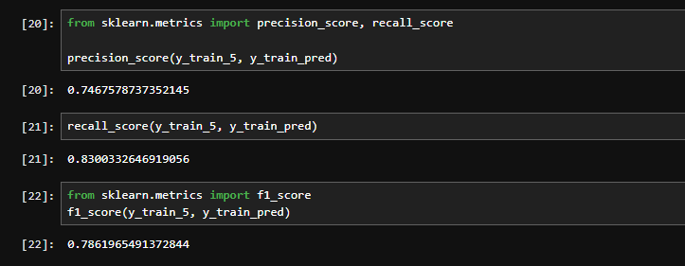
Precision Recall and F1 score
Precision = True Positive / True Positive + False Positive
Recall = True Positive / True Positive + False Negative
Figure: Precision Recall and F1 Score

Slide 8
Accuracy vs Precision vs Recall vs F1 Score
Metric | Definition | Use Cases
Accuracy | The proportion of correctly classified instances (both true positive and true negative) over all instances. | Measures the overall performance of a classifier.
Precision | The proportion of correctly classified positive instances over all instances that are classified as positive. | Measures the ability of the classifier to avoid false positives.
Recall | The proportion of correctly classified positive instances over all actual positive instances. | Measures the ability of the classifier to identify all actual positive instances.
F1 Score | The harmonic mean of precision and recall, providing a balanced measure of both precision and recall. | A good indicator of the performance of a classifier when the number of positive and negative instances is unbalanced.
Figure: Overall Comparison of Metrices

Slide 9
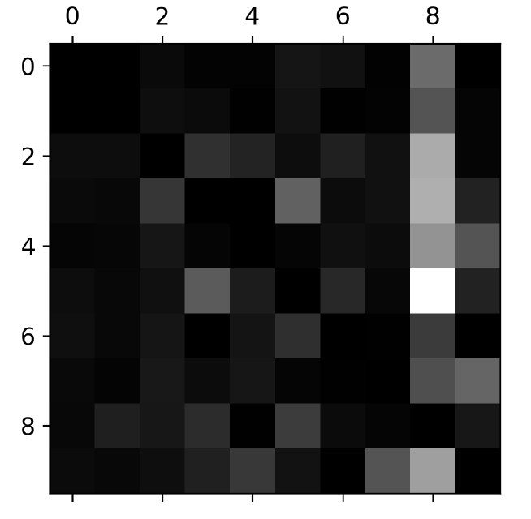
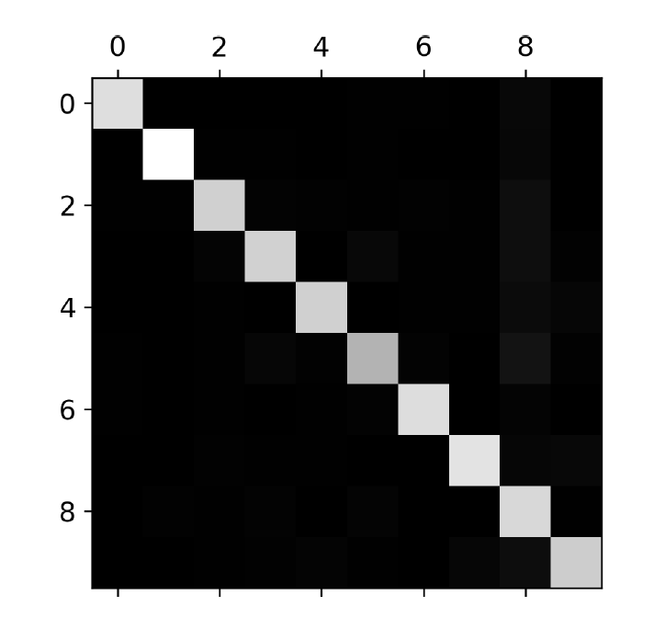
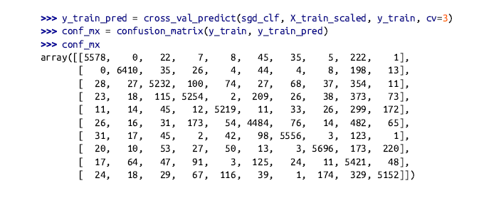
Error Analysis
Figure: Confusion Matrix

Slide 10
Summary
Accuracy metrics
Confusion Matrix
Precision
Recall
F1 Score
Error Analysis

Slide 11
Comparing OvA vs OvO
Strategy | Concept | Pros | Cons
One vs All | Train a model for each class vs all others | Simple implementation, handles some missing data | Imbalanced data issues, ignores relationships between classes
One vs One | Train a model for every unique class pair | Handles imbalanced data better | More complex to implement and train
Figure: OvA vs OvO

Slide 12
Thank You

